Slide 1



Violent Detection
Viên Minh Quang
Phạm Nguyễn Hoàng Long Phạm Lạc Duy

Slide 2

Contents:
Introduction
Methodology
Result
Future Development and Conclusion

Slide 3

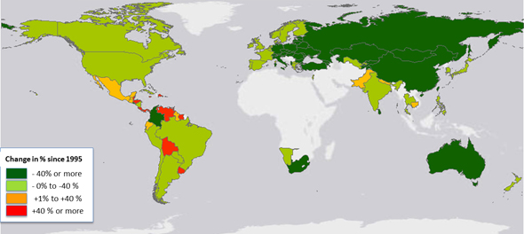
01 Introduction
Monitoring systems that can spot violent situations are becoming more and more crucial for efficient law enforcement and city security.
The effectiveness of violent event detectors is measured by their speed of response, accuracy, and generality over a wide range of video sources in different formats.
Numerous studies on violence identification either concentrated on speed, accuracy, or both without taking the generalizability across multiple video sources into account.

Slide 4

02 Methodology
YOLOv7
In the range of 5 FPS to 160 FPS, YOLOv7 outperforms all other known object detectors in terms of speed and accuracy, and on GPU V100, it has the greatest accuracy of 56.8% AP of all real-time object detectors with 30 FPS or more
YOLOv7-tiny is 127 FPS quicker and 10.7% more accurate on AP than YOLOv5-N. When compared to the equivalent YOLOv5-L with 99 FPS, the version YOLOv7-X gets 114 FPS inference speed, but YOLOv7 also achieves a higher accuracy (higher AP by 3.9%)..

Slide 5
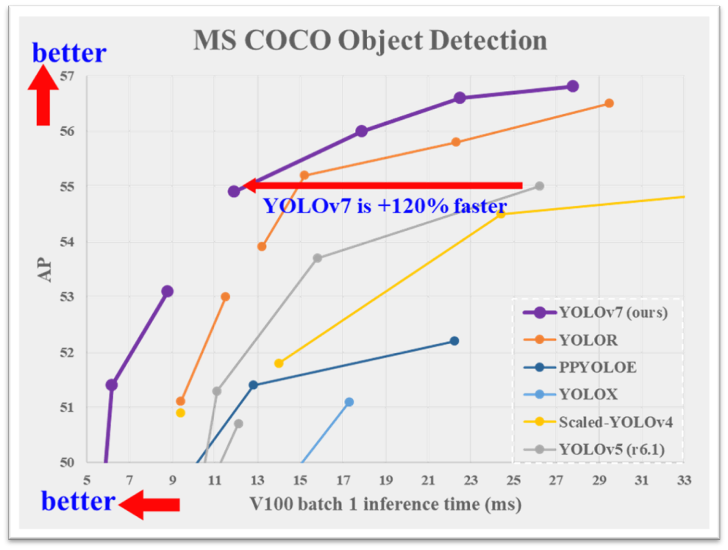

Slide 6


02 Methodology
Tool
•Web IDE for python: Google Colab
• Label tool: makesense.ai
Which is an online tool for labeling photos. Prepared labels can be downloaded in one of the multiple supported formats...

Slide 7
02 Methodology
Collecting Data
•To obtain the data, we recorded a group of volunteer VGU students and ourselves simulating real-life violent and nonviolent situations.
•All recorded videos are saved in MP4 video format and then extracted 2 frames per second using OpenCV in python. We also collected data from the internet.
•Our dataset includes 3483 images. There are 2265 images that represent non-violent behaviors and 2779 images that represent violent behavior

Slide 8
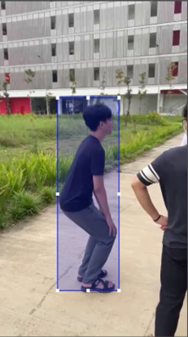
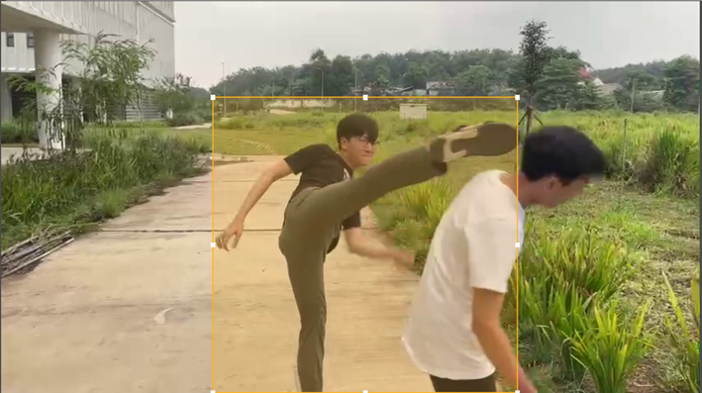
02 Methodology
All the actions in both violent and non-violent clips have been manually labeled.
Non - Violence
Violence

Slide 9
02 Methodology
System Construction
•Mounting Google Colab with Google Drive in order to manage YOLOv7 training sample and dataset.
•After that download YOLOv7 repository, install some requirements and directory the path to the YOLOv7. In our system, we use model yolov7.yaml

Slide 10
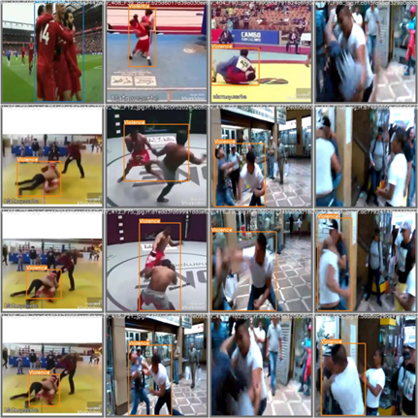
02 Methodology
Test Image
•Evaluating test images and displaying inference on all test images

Slide 11
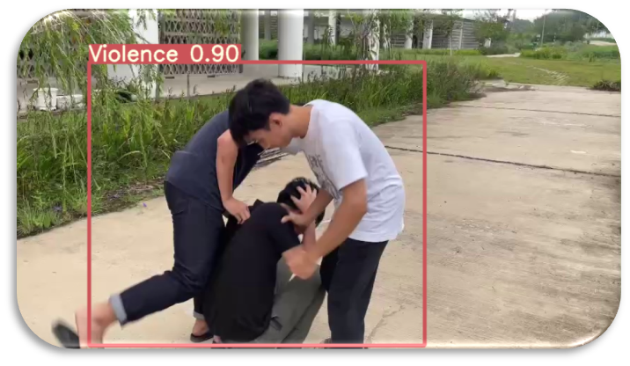
02 Methodology
Inference on Single Image
•Then begin to infer and apply Non-Maximum Suppression(NMS). It uses to whittle down many detected bounding boxes to only a few. Once the detector outputs a large number of bounding boxes, it is necessary to filter out the best ones.

Slide 12
02 Methodology
Inference on Video
•We can infer video from the local System or download video from google drive.
• First, we initialize the video object and set the Video information
•We create an object for writing video output. Then after initializing the model and loading FP32 model, we set the model for inference.
•It also needs Non-Max suppression (NMS). The system will detect per class and decide the object in that frame is violent or non-violent. Then release the output

Slide 13
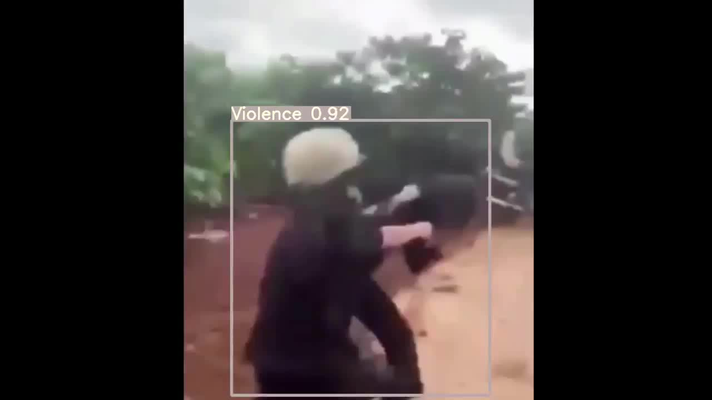

Slide 14
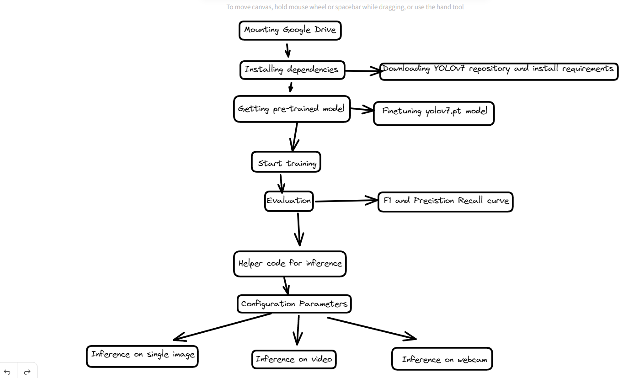
02 Methodology

Slide 15
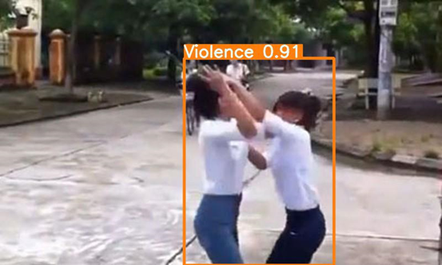
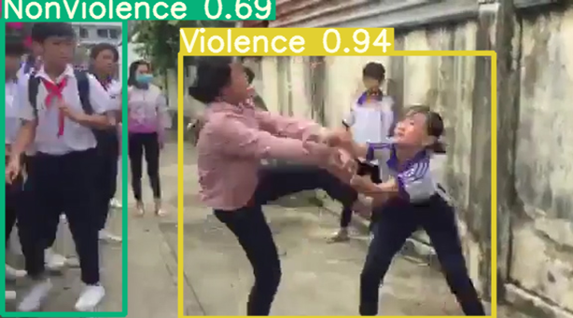
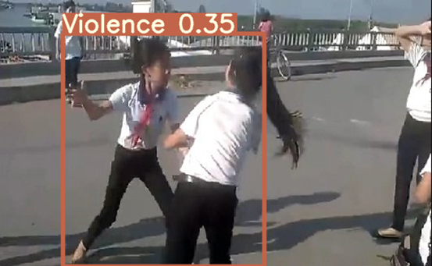
03 Result

Slide 16
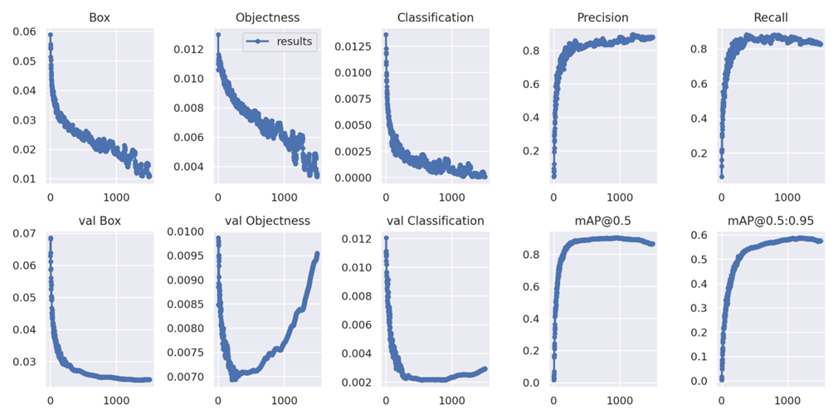
03 Result
Benchmark Data

Slide 17
03 Result
Strength
Weakness
•Violence detection might misunderstand that someone acting violently because they are wearing too bright clothing.
•Cannot precisely identify on photos or videos with an excessive number of people.
•Not yet available for online use
•The types of armed violence have not yet been diversified
•Can process images and videos
•High accuracy for non-armed violent acts
•Real-time violence detection via webcam
•Can be used on the local network
•User-friendly interface, easy to use website

Slide 18
04 Future Development
Future Development
Future study needs to consider more complex situations about:
•More diverse image sources
• Armed violence
• Online website
•Communication with local authorities and the owners of security system via SMS or email.

Slide 19
04 Future Development
Conclusion
By taking violent object detection from photographs into consideration, the cutting-edge YOLO (you only look once) deep-learning-based algorithm's detection capabilities have been examined. The YOLOv7 model was trained with violent and nonviolent photos from our own dataset and real-world events for the model search component to improve the performance of the YOLOv7 model and enable it to detect violence with AP values as high as 86.6 percent.

